Slide 1
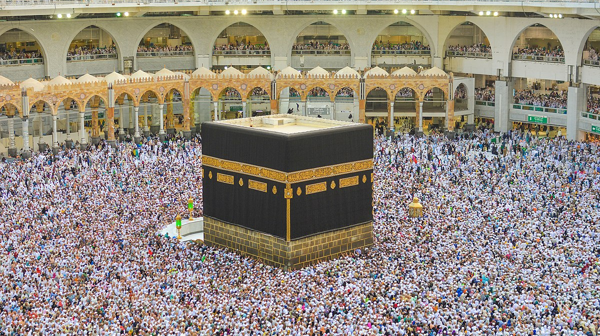
Chapter 3 review
Islam

Slide 2
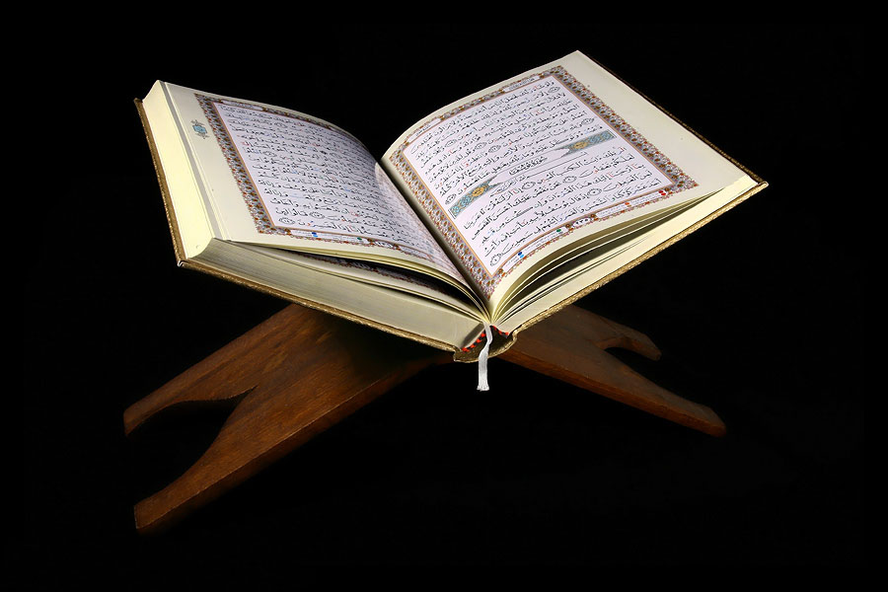
What is a Muslim place of worship called?
What type of religion is Islam considered? (hint – One God)
Mosque
Monotheist
List the 5 pillars of Islam.
Belief
Prayer (5 times a day)
Charity
Fasting
Pilgrimage
Whom do Muslims recognize as the final prophet from God?
Muhammad
What is the Holy city of Islam and the shrine that resides there?
What is the holy book of Islam that provides Muslims guidance?
Mecca and the shrine is called the Kaaba
Quran

Slide 3
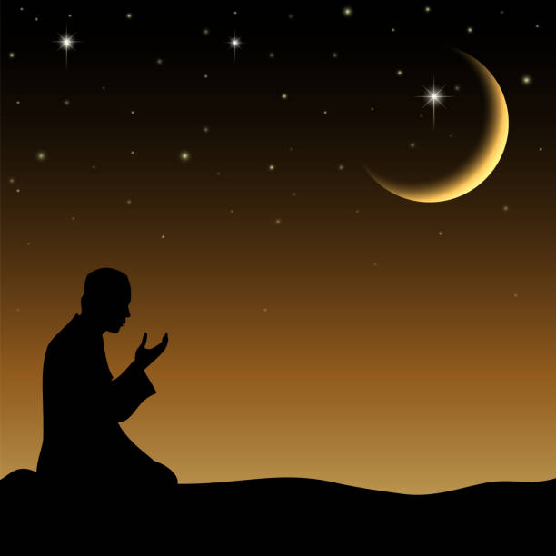
After Muhammad’s death Islam split into two groups…identify them.
Identify the Islamic Code of Laws
Shariah
Sunni and Shia
A set of customs and beliefs based off of the Quran and Shariah.
What was the name of the Caliphate that the Sunni’s recognized?
Sunnah
Umayyads
What are followers of Islam called?
Muslims

Slide 4
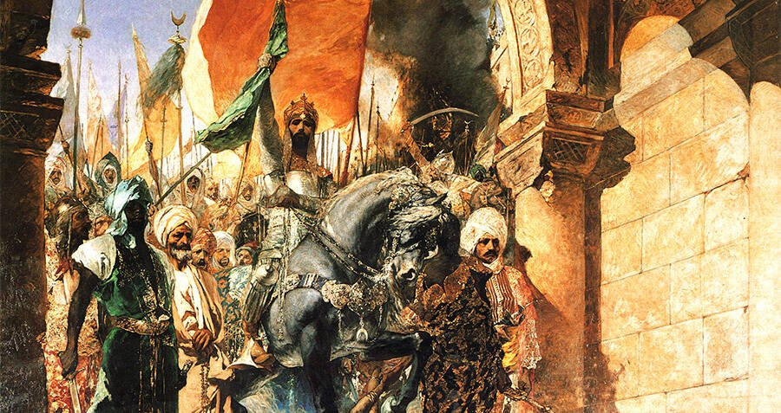
What conqueror defeat the Byzantine Empire and captured the city of Constantinople?
How did Muslim merchants, armies, and Sufis contribute to the Middle Eastern world?
Mehmet II
They spread the Arabic Language and the religion of Islam
Who was considered the greatest Ottoman sultan?
Suleiman I
What type of climate best describes the Arabian peninsula?
Desert

Slide 5
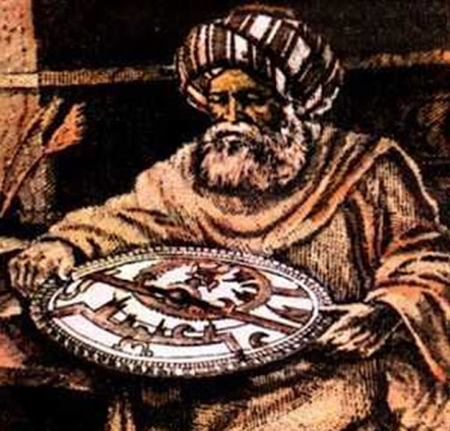
Which field of mathematics was invited by the Muslim scholars?
Arabic numerals were first learned form what group of people?
Algebra
Hindus
Muslims discouraged _________ in their art.
Living things

